Slide 2

Object Oriented Programming

Slide 3
Operators and Expressions
Arithmetic Operations
There are several binary arithmetic operators that operate on any of the primitive numerical types:
+ addition
- subtraction (also used for negation)
* multiplication
/ division
% remainder
Integer Arithmetic: Integer arithmetic is two's-complement arithmetic.
Exp: 7/2 = 3, and -7/2 = -3 and 7%2 = 1, and -7%2 = 1.
Exp: Dividing by zero or remainder by zero is invalid for integer arithmetic and
throws ArithmeticException.

Slide 4
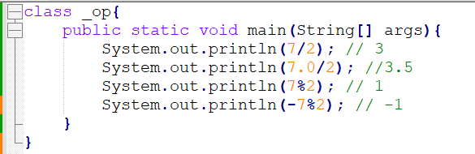

Slide 5
Floating Arithmetic:
Arithmetic with finite operands performs as expected, within the limits of precision of double or float.
In java we can have results of floating point arithmetic as infinity and NaN(Not-a-Number).
NaN (Not-a-Number):
NaN represents a value that is not a valid number in the usual sense.
It is typically the result of operations that produce undefined or indeterminate results, such as dividing zero by zero or taking the square root of a negative number.
NaN values are often used to indicate that a computation could not produce a meaningful result due to mathematical or computational reasons.
If you perform arithmetic involving a NaN, the result will also be NaN.
We can test for NaN using the Double.isNaN() or Float.isNaN() methods.
We can also assign NaN to a variable.

Slide 6
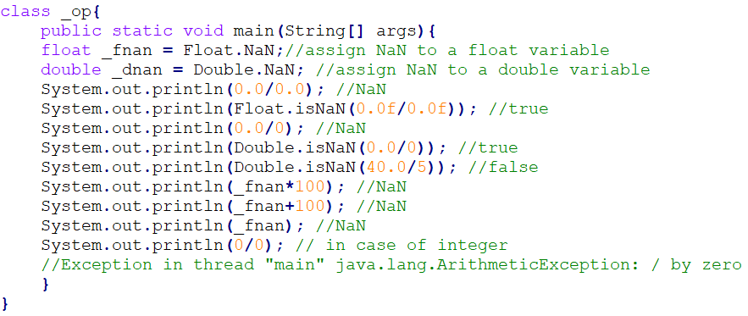

Slide 7
Infinity:
Infinity represents a value that is greater than any finite number.
Positive and negative infinity are used to indicate unbounded values in the positive or negative direction, respectively.
Infinity can result from operations like dividing a nonzero number by zero or performing calculations that exceed the representable range of floating-point numbers.
Arithmetic operations involving infinity follow mathematical rules, and they can lead to results that are still infinity.
You can test for infinity using the Double.isInfinite() or Float.isInfinite() methods.

Slide 8
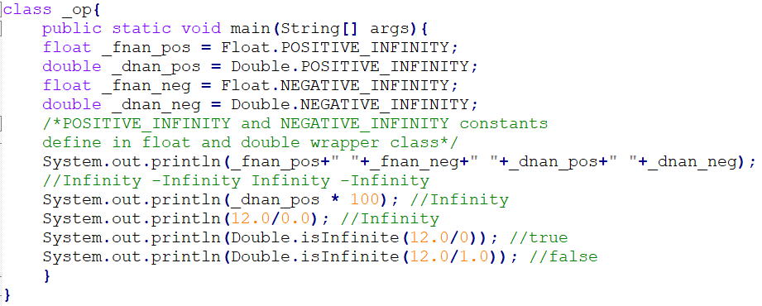

Slide 9
Operators and Expressions contd..
3. Strict and Non-Strict Floating-Point Arithmetic: (No more required)
Floating-point arithmetic can be executed in one of two modes: FP-strict or not FP-strict.
strictfp: you will always get exactly equivalent results on all JVM implementations.
Non-strictfp: executed with somewhat relaxed rules.
When you declare a method strictfp, all the code in the method will be executed according to strict constraints.

Slide 10
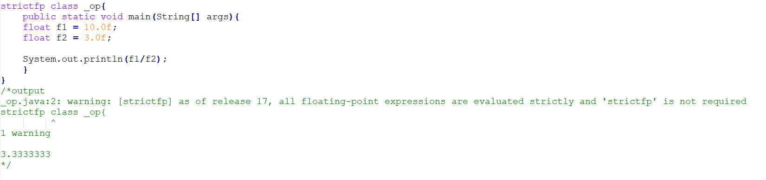

Slide 11
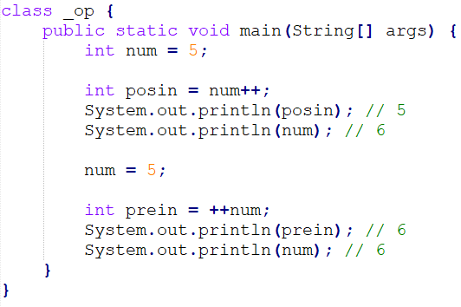
Operators and Expressions contd..
General Operators:
Increment and Decrement Operators: The ++ and -- operators are the increment and decrement operators and can only be applied to numeric variables or numeric array elements.

Slide 12
Operators and Expressions contd..
Relational :
>: Greater than
<: Less than
>=: Greater than or equal to
<=: Less than or equal to
Equality Operators:
==: Equal to (for primitive types, compares values)
!=: Not equal to (for primitive types, compares values)
.equals(): Equal to (for objects, compares content)

Slide 13
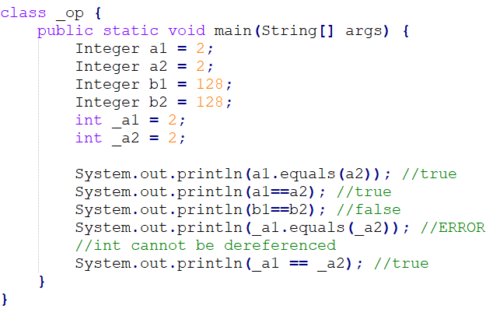

Slide 14
Concept of Integer caching
"Integer caching" is a memory optimization technique used in Java to improve performance and memory usage when dealing with small integer values. It involves reusing a limited set of Integer objects for frequently used integer values within a specific range. This range is typically -128 to 127.
Caching Range: Java caches Integer objects for integer values within the range of -128 to 127.
Reuse of Objects: When you create an Integer object with a value within the caching range, Java checks if an Integer object with the same value already exists in memory. If it does, the existing object is reused. This means that multiple references can point to the same Integer object.
Memory Savings: Reusing Integer objects saves memory because you're using the same object for the same value, rather than creating a new object each time.

Slide 15
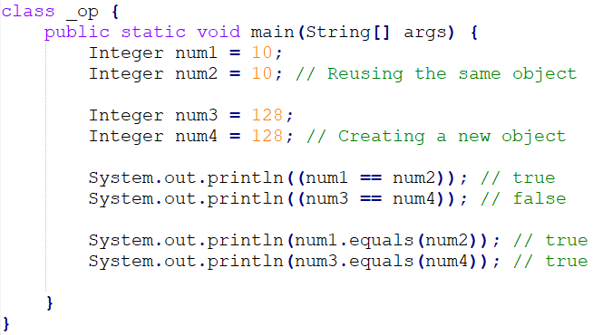

Slide 16
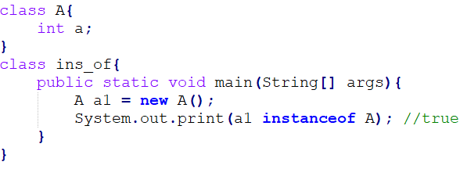
Operators and Expressions contd..
Instanceof: The instanceof operator evaluates whether a reference refers to an object that is an instance of a particular class or interface.

Slide 17
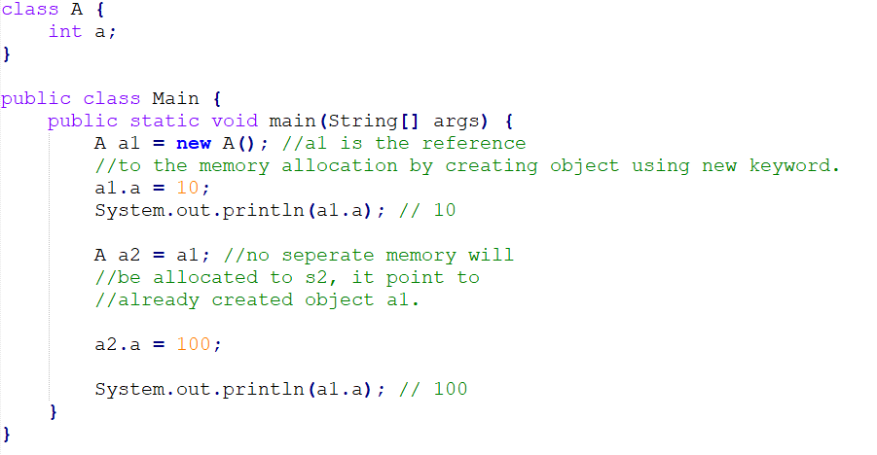
Reference vs objects

Slide 18
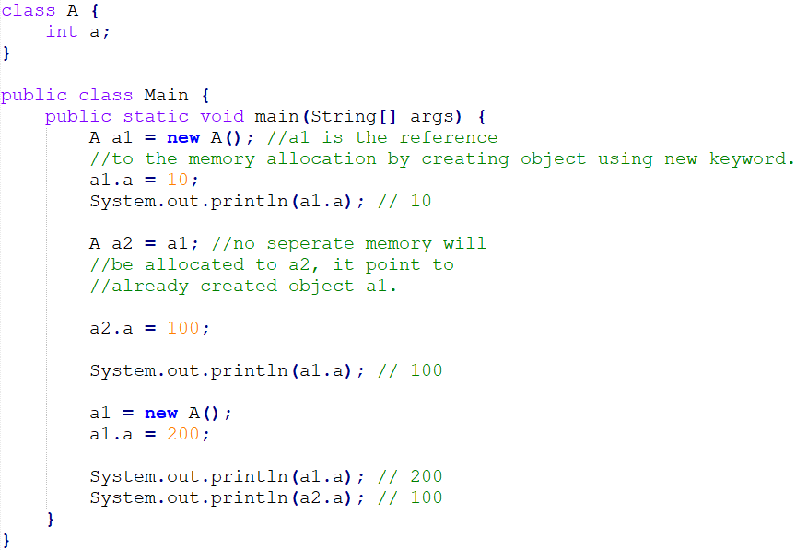
Reference vs objects

Slide 19
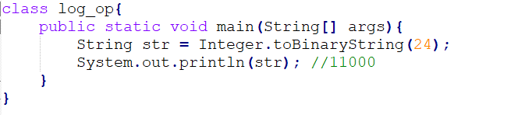
Integer to binary

Slide 20
Operators and Expressions contd..
Logical and bitwise Operators:
! Logical negation
&& Logical AND
|| Logical OR
& Bitwise AND
| Bitwise OR
^ Bitwise exclusive or (XOR)

Slide 21
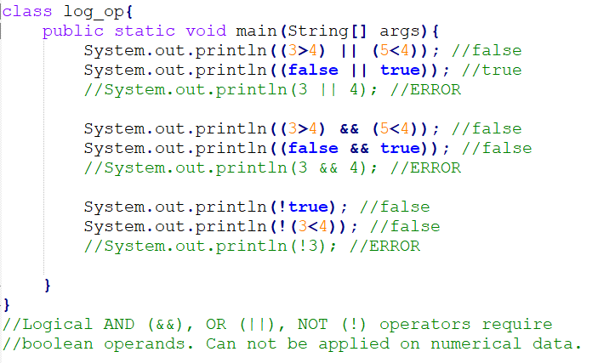
Example of logical AND, OR, NOT

Slide 22
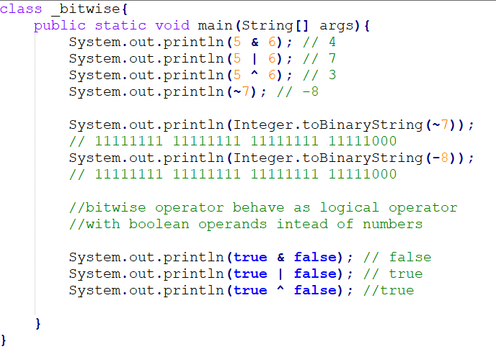
Example of logical AND, OR, NOT…

Slide 23
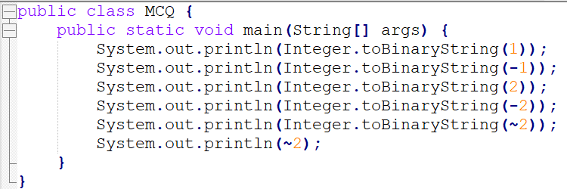
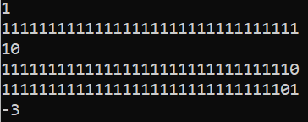
More on Bitwise NOT

Slide 24
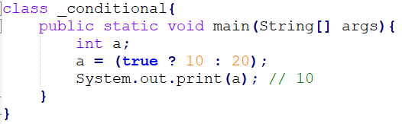
Operators and Expressions contd..
The Conditional Operator ?:
It takes three operands and is represented by the ? : symbols. It's often used as a shorthand for simple if-else statements.
value = (userSetIt ? usersValue : defaultValue);
is equivalent to
if (userSetIt)
value = usersValue;
else
value = defaultValue;

Slide 25
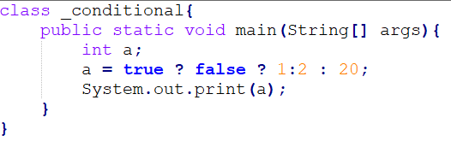
True
False
1
2
20

Slide 26
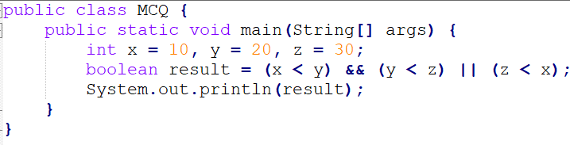
True
False
Error
NaN

Slide 27
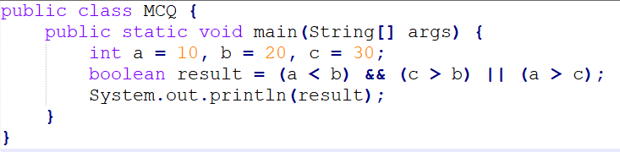
True
False
Error
NaN

Slide 28
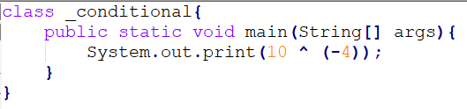
-10
10
-20
Error
NaN

Slide 29
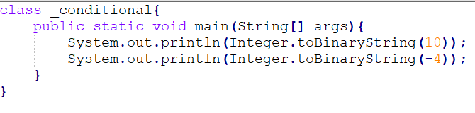
1010 and 11111111111111111111111111111100
1010 and 11111111111111111111111111111010
00000000000000000000000000001010 and 11111111111111111111111111111010
00000000000000000000000000001010 and 11111111111111111111111111111100

Slide 30
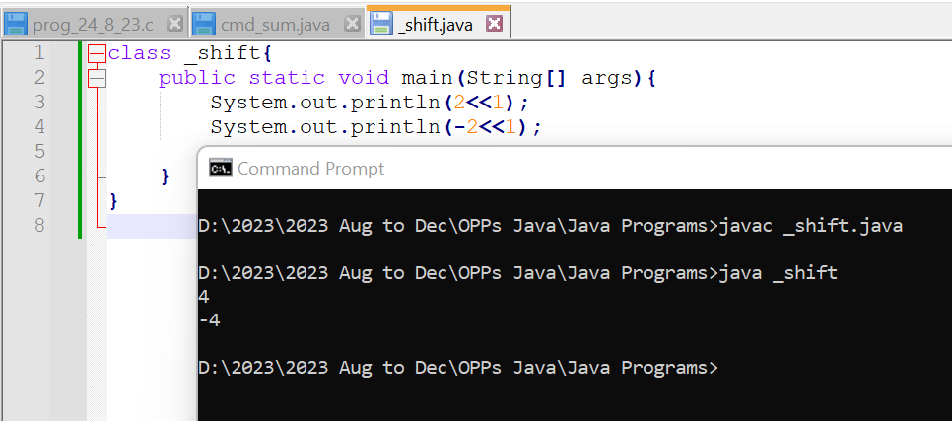
Operators and Expressions contd..
Shift Operators:
Left Shift: the left shift operator (<<) is used to shift the bits of a binary number to
the left by a specified number of positions.
result = value << numPositions;

Slide 31
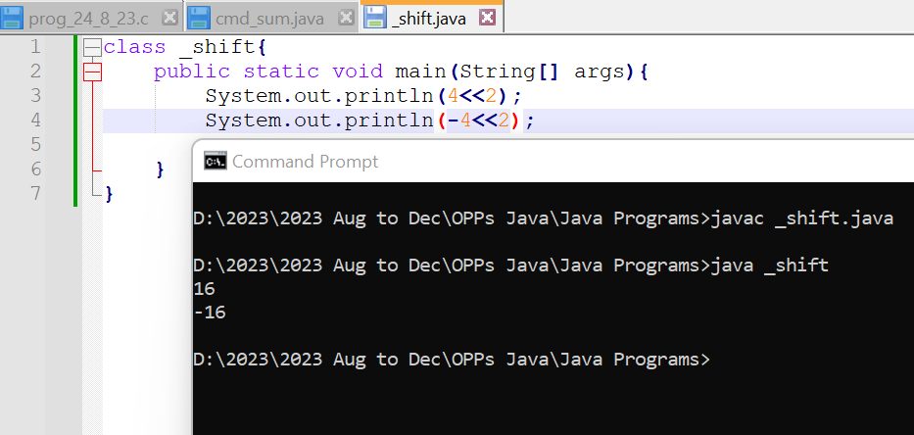
Left Shift Examples

Slide 32
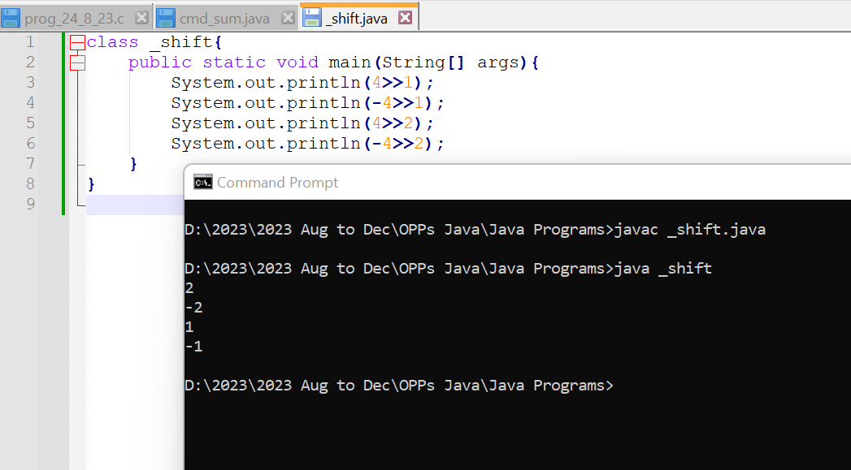
Shift Operators:
Right Shift: The >> operator performs a signed right shift. It shifts the bits to the
right by the specified number of positions.
result = value >> numPositions;

Slide 33
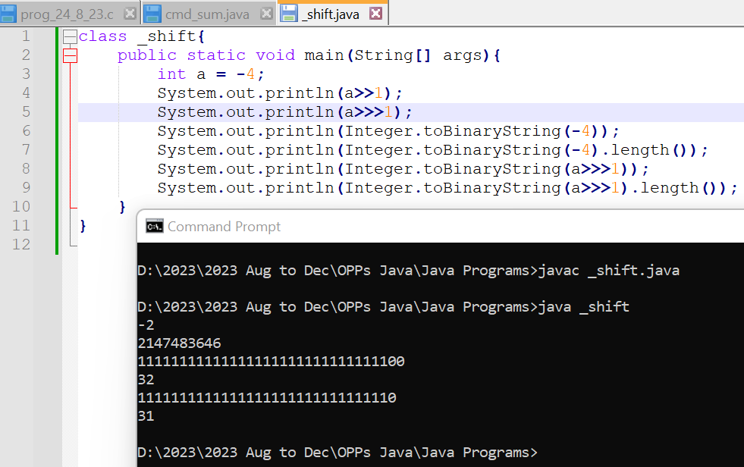
Unsigned Right Shift: The >>> operator shifted the bits to the right by the specified number of positions, and
the leftmost positions are filled with zeros, regardless of the original sign bit.
Unlike the signed right shift operator (>>), which preserves the sign bit when shifting.
result = value >> numPositions;

Slide 34
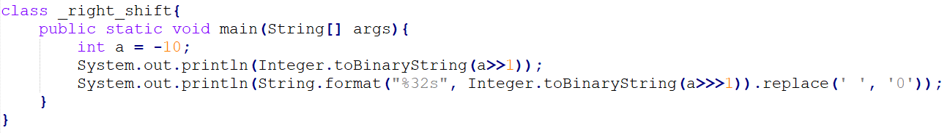
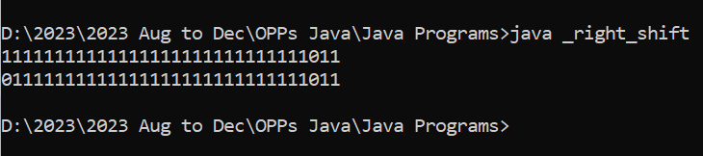
More Examples on right and unsigned right shift operator

Slide 35
Operators and Expressions contd..
Assignment Operators:
z = 3;
x = y = z = 3;
a *= b + 1 is analogous to a = a * (b + 1)
String Concatenation Operator:
You can use + to concatenate two strings.
String boo = "boo";
String cry = boo + "hoo";
cry += "!";
System.out.println(cry);
new: The new operator is a unary prefix operator. It has one operand that follows the operator. Technically, the use of new is known as an instance creation expression because it creates an instance of a class or array.

Slide 36
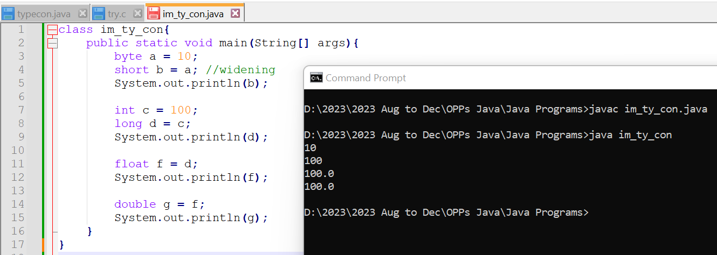
Operators and Expressions contd..
Type Conversions
Implicit Type Conversions(Widening):
The conversion involves a smaller data type to the larger type size. For example, the byte datatype implicitly typecast into short, char, int, long, float, and double.
Conversion Hierarchy: The hierarchy generally goes from smaller to larger range and precision. For example: byte → short → int → long → float → double.

Slide 37
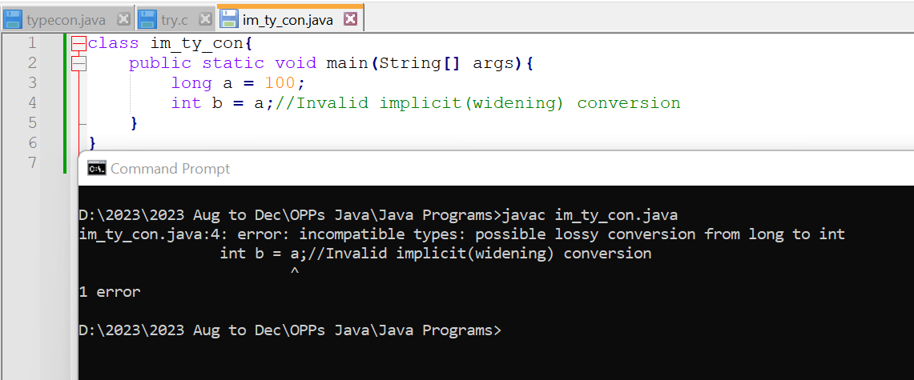
Operators and Expressions contd..
Invalid implicit Type Conversions(Widening):

Slide 38
Operators and Expressions contd..
Explicit Type Casts:
Explicit type conversion in Java, also known as type casting, involves manually converting a value from one data type to another.
String Conversions:
Whenever a + operator has at least one String operand, it is interpreted as the string concatenation operator and the other operand, if not a String, is implicitly converted into a String. Such conversions are predefined for all primitive types.
To explicitly cast a value from one data type to another, you use parentheses with the target data type inside them.
Explicit type casting often involves
narrowing the data type. This means
converting a larger data type to a
smaller one.

Slide 39
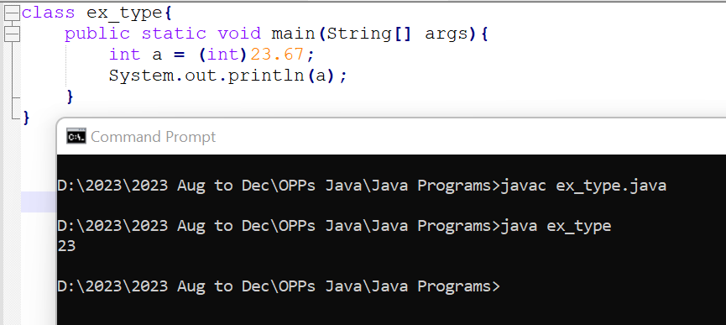

Slide 40
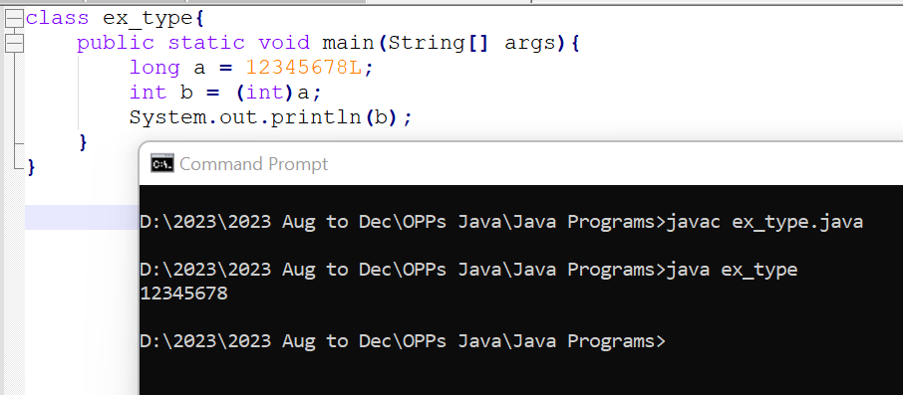
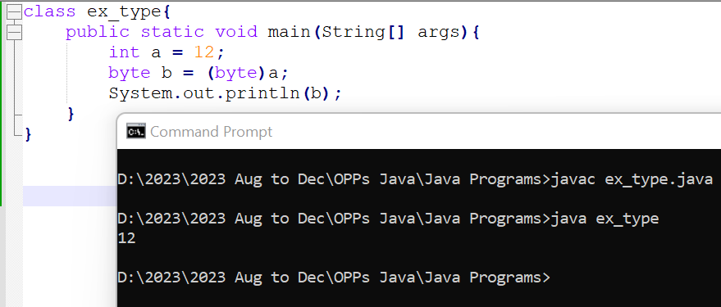

Slide 41
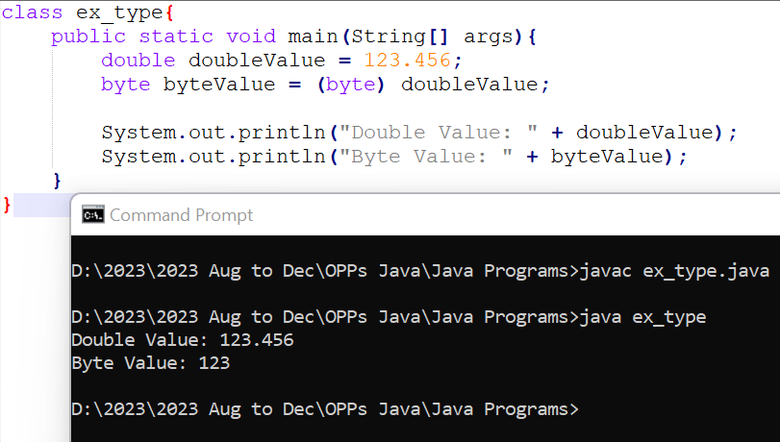
Lossy Conversion: Double to Byte

Slide 42
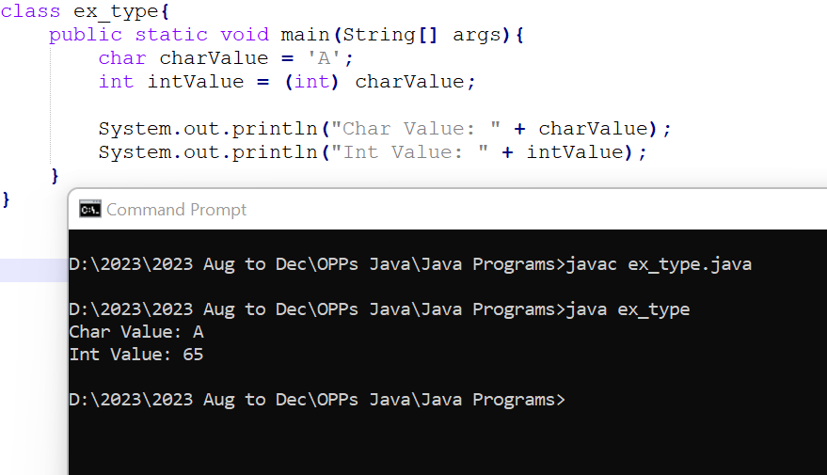
Unicode Conversion: Character to Integer

Slide 43
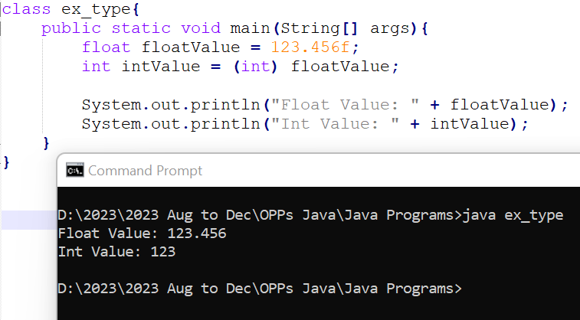
Floating-Point Truncation: Float to Integer

Slide 44
Operators and Expressions contd..
Operator Precedence and Associativity
postfix operators [] . (params) expr++ expr--
unary operators ++expr --expr +expr -expr ~ !
creation or cast new (type)expr
multiplicative * / %
additive + -
shift << >> >>>
relational < > >= <= instanceof
equality == !=
AND &
exclusive OR ^
inclusive OR |
conditional AND &&
conditional OR ||
conditional ?:
assignment = += -= *= /= %= >>= <<= >>>= &= ^= |=

Slide 45
Operators and Expressions contd..
All binary operators except assignment operators are left-associative. Assignment is right-associative. In other words, a=b=c is equivalent to a=(b=c), so it is convenient to chain assignments together. The conditional operator ?: is right-associative.

Slide 46
Control Statements

Slide 47
Jump statement
Continue
Break
Goto statement (No goto statement in java)

Slide 48
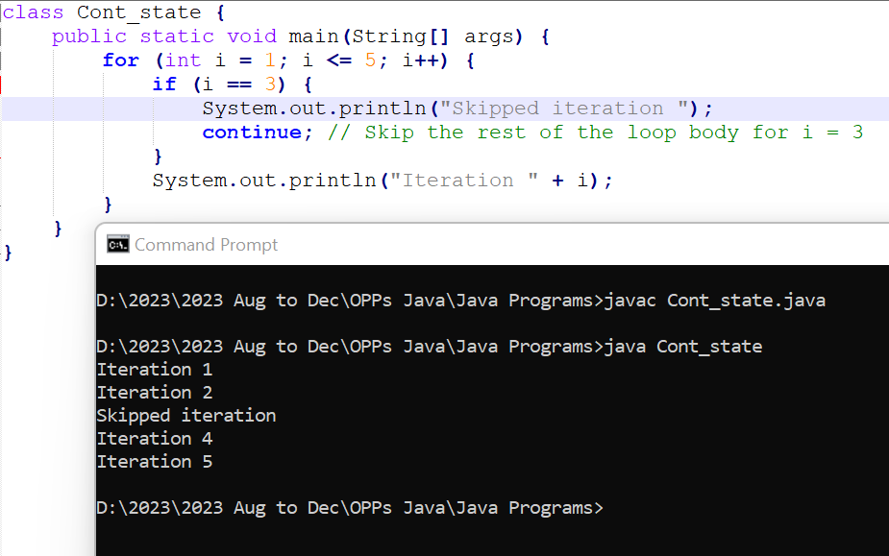
Continue statement

Slide 49
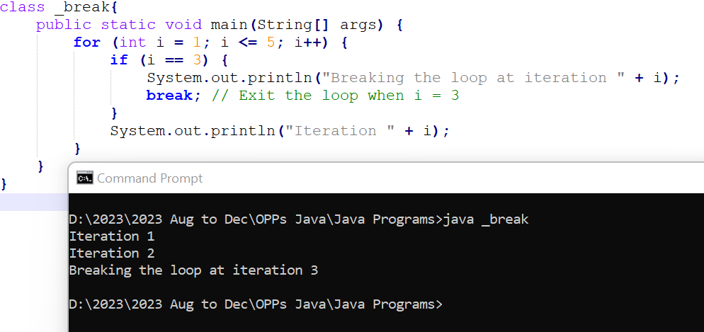
Break statement

Slide 50
Java’s Selection Statements
Java supports two selection statements: if and switch.
These statements allow you to control the flow of your program’s execution based upon conditions known only during run time.
If
The if statement is Java’s conditional branch statement.
The general form of the if statement:
if (condition) statement1;
else statement2;
Here, each statement may be a single statement or a compound statement enclosed in curly braces (that is, a block).
The condition is any expression that returns a boolean value.
The else clause is optional.

Slide 51
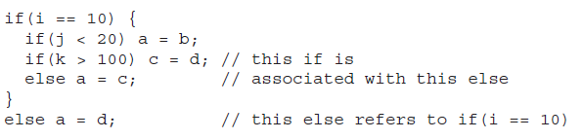
Nested ifs
A nested if is an if statement that is the target of another if or else.
When you nest ifs, the main thing to remember is that an else statement always refers to the nearest if statement that is within the same block as the else and that is not already associated with an else.

Slide 52
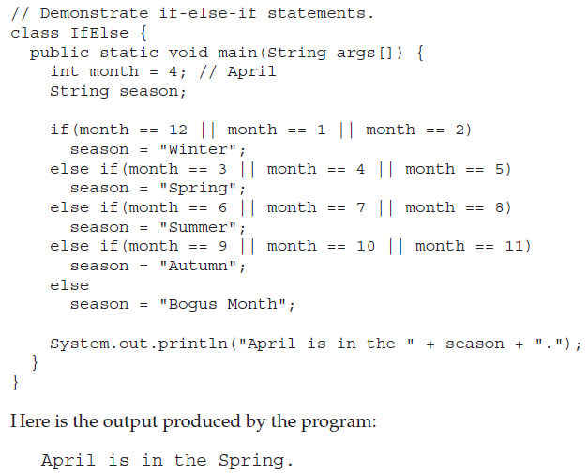
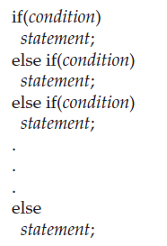
The if-else-if Ladder

Slide 53
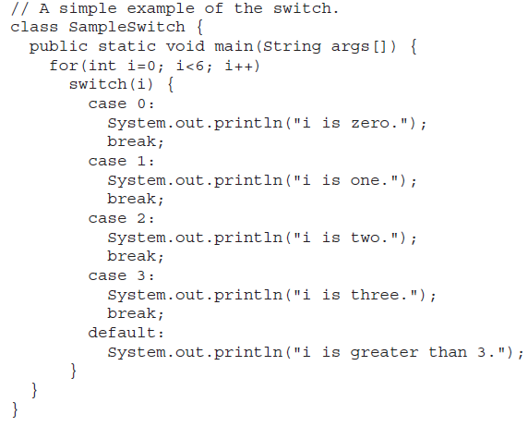
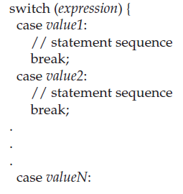
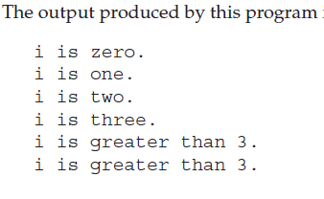
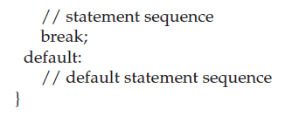
switch
The switch statement is Java’s multiway branch statement.
It provides an easy way to dispatch execution to different parts of your code based on the value of an expression.

Slide 54
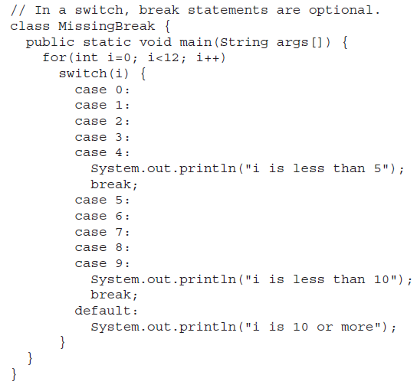
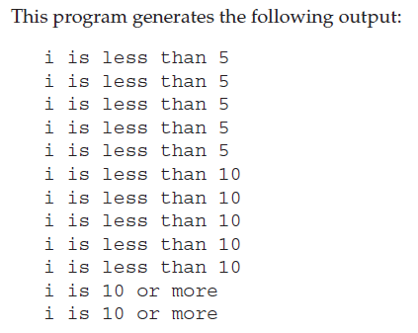

Slide 55
Iteration Statements
Java’s iteration statements are for, while, and do-while.
These statements create what we commonly call loops.
While
It repeats a statement or block while its controlling expression is true. Here is its general form:
while(condition) {
// body of loop
}
The condition can be any Boolean expression.
The body of the loop will be executed as long as the conditional expression is true.
When condition becomes false, control passes to the next line of code immediately following the loop.
The curly braces are unnecessary if only a single statement is being repeated.

Slide 56
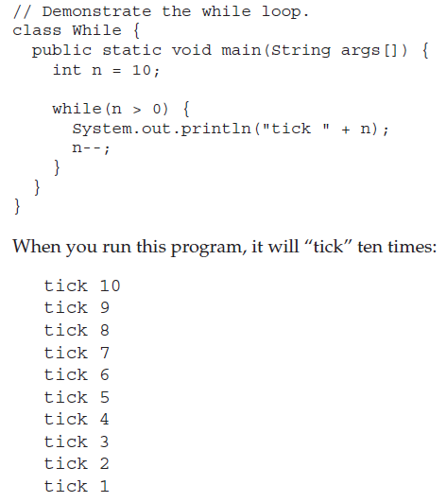
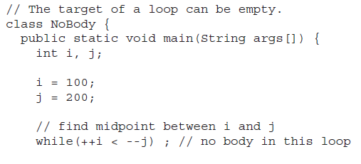
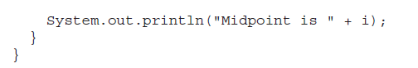
The body of the while (or any other of Java’s loops) can be empty.
This is because a null statement (one that consists only of a semicolon) is syntactically valid in Java.

Slide 57
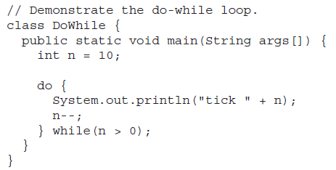

do-while
The do-while loop always executes its body at least once, because its conditional expression is at the bottom of the loop. Its general form is
do {
// body of loop
} while (condition);
Each iteration of the do-while loop first executes the body of the loop and then evaluates the conditional expression.
If this expression is true, the loop will repeat. Otherwise, the loop terminates.

Slide 58

for
The general form of the traditional for statement:
for(initialization; condition; iteration) {
// body
}
If only one statement is being repeated, there is no need for the curly braces.
When the loop first starts, the initialization portion of the loop is executed.
Generally, this is an expression that sets the value of the loop control variable, which acts as a counter that controls the loop.
Next, condition is evaluated. This must be a Boolean expression.
It usually tests the loop control variable against a target value.
If this expression is true, then the body of the loop is executed. If it is false, the loop terminates.
Next, the iteration portion of the loop is executed. This is usually an expression that increments or decrements the loop control variable.

Slide 59


The For-Each Version of the for Loop
Java adds the for-each capability by enhancing the for statement.
The advantage of this approach is that no new keyword is required, and no preexisting code is broken.
The for-each style of for is also referred to as the enhanced for loop.
The general form of the for-each version of the for is:
for(type itr-var : collection) statement-block
Here, type specifies the type and itr-var specifies the name of an iteration variable that will receive the elements from a collection, one at a time, from beginning to end.
With each iteration of the loop, the next element in the collection is retrieved and stored in itr-var.
The loop repeats until all elements in the collection have been obtained.

Slide 60


Slide 61


Jump Statements
Java supports three jump statements: break, continue, and return.
These statements transfer control to another part of your program.
Using break
By using break, you can force immediate termination of a loop, bypassing the conditional expression and any remaining code in the body of the loop.
When a break statement is encountered inside a loop, the loop is terminated and program control resumes at the next statement following the loop.

Slide 62

Using break as a Form of Goto
The general form of the labeled break statement is shown here:
break label;
label is the name of a label that identifies a block of code.

Slide 63




Using continue
A continue statement causes control to be transferred directly to the conditional expression that controls the loop.

Slide 64


return
The return statement is used to explicitly return from a method.
It causes program control to transfer back to the caller of the method.
At any time in a method the return statement can be used to cause execution to branch back to the caller of the method.
Thus, the return statement immediately terminates the method in which it is executed.

Slide 65
References
Gosling, J., Holmes, D. C., & Arnold, K. (2005). The Java programming language.

